Slide 1
Strategic Development Fund – Green Skills
In summary, significant funding for colleges to invest in new equipment and provide new and improved course offers in key areas:
Electric/Hybrid Vehicle
Retrofit
Alongside internal training in Sustainability (through Sustainable Development Goals)

Slide 2
Sustainable Development Goals & Collective Action Planning
Shipley College as lead
Learning Influencer/Sustainability Champion in each college (Bradford College, Calderdale College, Kirklees College, Shipley College, Luminate Education Group, Heart of Yorkshire Education Group, Notre Dame Sixth Form College)
College outputs
Introduction to the Sustainable Development Goals (SDGs) and Shipley’s journey
SDG training on the SDG process
Shipley mentoring and action planning

Slide 3
The Sustainable Development Goals
Celebrating Progress and Projecting Influence

Slide 4
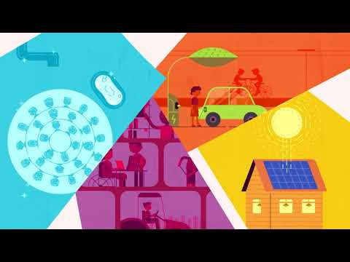
What are the Sustainable Development Goals (SDGs)?

Slide 5
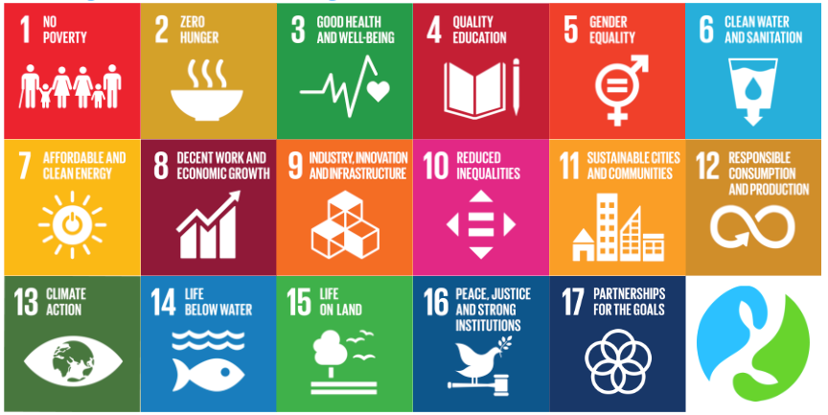
The SDGs can be used as a blueprint for peace and prosperity for the people and the planet - now and into the future
These 17 SDGs are integrated - they recognise that action in one area will affect outcomes in others, and that development must balance social, economic and environmental sustainability
https://sdgs.un.org/goals/goal4
Without anymore information than is on the screen - which would you say your business naturally ‘achieves’…

Slide 6
Assessing your starting point…
Operationally - what SDG work is happening on the ground?
Most, if not all organisations will be engaged in work that supports progress towards achieving some of the sustainable development goals
Quantification is key to determining where best to allocate your resources and energy
Rationalisation - can all organisations promote every SDG?

Slide 7
Task: Operational
What are you currently doing within your organisation that can be linked in with the SDGs?
Brainstorm in pairs/groups anything you have done this year at work that can be linked back to one or more of the SDGs…

Slide 8
Feedback & Discussion…
Examples of projects and work completed this year that can be linked back to one of the SDGs

Slide 9
Task: Calendar - what will your sustainable year look like?
The SDGs are so broad in scope - that it can be tempting to create some ‘tenuous’ links to activities…
What opportunities do you think we are missing?
How will you raise awareness of the opportunities?
Fill out the SDG quality calendar with your cool ideas :)

Slide 10
Feedback & Discussion…
What activities have you added that will inspire SDG engagement?
What do you need to make those happen?
Which can we collaborate on as a collective to make a
whole WY thing?

Slide 11
Task: Strategic
Strategically - how do your policies & procedures drive progress towards achieving the SDGs?
Using one of your own policies/or this sample - cross reference the elements from SDG1 to SDG17
Use a 0 to 4 scale in which:
0 is little to no alignment
4 is significant alignment

Slide 12
Feedback & Discussion…
How did your policy link to the SDGs

Slide 13
Measurement and Consistency
SDG Accord
https://www.sdgaccord.org/
Reporting
https://www.sdgaccord.org/files/sdg_accord_2022_reporting.pdf
Sustainability Leadership Scorecard – Environmental Alliance of Universities and Colleges (EAUC)
https://www.eauc.org.uk/sustainability_leadership_scorecard

Slide 14
Next Steps
This is a session that we have run with teachers, support assistants and executive members
The key is which parts to emphasise
Aligning with the SDGs is going to need wider organisational buy-in, but start with the cheap/free/big/visible - generate some SDG currency - and then spend it on the infrastructure
Questions please :)
goshea@shipley.ac.uk

