Slide 1
Sustainability and the Sustainable Development Goals Cascade Presentation
(SDGs)
Please log group attendance and feedback: https://forms.gle/ykgZnYDb36GdnSXw7
OR individual attendance and feedback: https://www.surveymonkey.co.uk/r/SDGactivitysurvey
Collaborate: Share and celebrate good practice

Slide 2
SDG Context
The 2030 Agenda for Sustainable Development, adopted by all United Nations Member States in 2015, provides a shared blueprint for peace and prosperity for people and the planet, now and into the future.
At its heart are the 17 Sustainable Development Goals (SDGs), which are an urgent call for action by all countries - developed and developing - in a global partnership.
They recognize that ending poverty and other deprivations must go hand-in-hand with strategies that improve health and education, reduce inequality, and spur economic growth – all while tackling climate change and working to preserve our oceans and forests.

Slide 3
SDGs – What are they?
The SDGs can be used as a blueprint for peace and prosperity for the people and the planet - now and into the future
These 17 SDGs are integrated - they recognise that action in one area will affect outcomes in others, and that development must balance social, economic and environmental sustainability
https://sdgs.un.org/goals
1. Overview of STGs: context and value

Slide 4
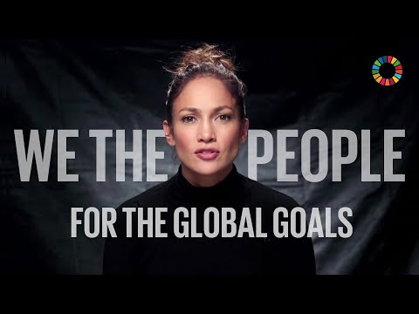
SDGs Global Involvement

Slide 5
SDGs Dominoes
Match the SDG icon to its themed title:
Partnerships for the goals
Good health and wellbeing
Life on land
Decent work and economic growth
Climate action
Industry innovation and infrastructure
Clean water and sanitation
Gender equality
Responsible consumption and production
Quality education
No poverty
Affordable and clean energy
Peace justice and strong institutions
Zero hunger
Reduced inequalities
Life below water
Sustainable cities and communities
1. Overview of STGs: context and value
Notes:
Print off

Slide 6
SDG Scores are in!
7. Quiz

Slide 7
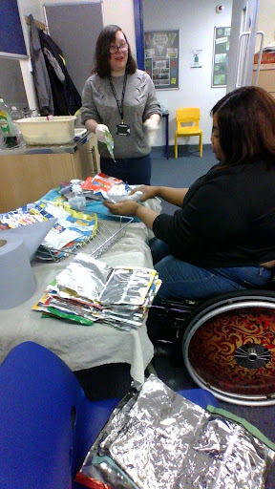
Celebrate what you have already done
Small Group Task:
Look at the 17 SDG’s - maybe just the ones you are drawn to as part of your role and share an example of projects and work completed this year that made a sustainable impact and can be linked back to one or more of the SDGs: https://sdgs.un.org/goals
Action/ event example
Which SDGs does it link to ?
Upload a photo where possible to link below
What was the impact?
Did it influence on policy, process or practice?
Complete the Google Form https://forms.gle/ykgZnYDb36GdnSXw7
7. Quiz
Notes:
Ahead of the game

Slide 8
Where are the gaps?
Are there any areas important to your areas development that you need to cover or expand?
NB Remember not every department or organisation needs to cover all of them

Slide 9
Useful resources
SDGs: THE 17 GOALS | Sustainable Development
SDG Accord – staff survey available SDG Accord
Reporting SDGs https://www.sdgaccord.org/files/sdg_accord_2022_reporting.pdf
We are a member of the EAUC (Environmental Alliance of Universities and Colleges) and are using their Sustainability Leadership Scorecard – lots of resources available https://www.eauc.org.uk/sustainability_leadership_scorecard
Delivering Sustainable Education: https://feweek.co.uk/supporting-delivery-of-sustainability-education-to-meet-future-skill-demands/
Resources/ CPD/ curriculum mapping/ teaching sustainability in subject areas https://www.et-foundation.co.uk https://www.et-foundation.co.uk/resources/esd/esd-resources/esd-in-different-subject-areas/
Carbon Literacy Project roll out – helps to raise awareness of impact of actions and choices at work and home and find solutions which improves wellbeing and decreases bills!

Slide 10
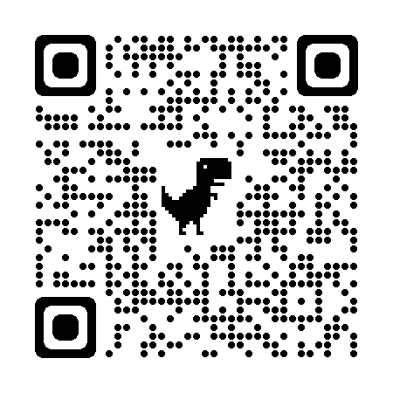
Feedback
Please……feedback: via a very short DFE survey monkey link
regarding SDGs now …….as we are part of a successful bid for
funds to promote SDGs your feedback is of real value ….thank you :)
https://www.surveymonkey.co.uk/r/SDGactivitysurvey

Slide 11
Thank you again!
For your time, consideration and care for everyone and the planet

