Slide 1
What we have done and we are doing
Incorporating SDGs into lessons in teacher ed- done and ongoing
Roller banners - done
Policy updates- meeting with quality manager next week
Supported to risk assess how a policy aligns with an SDG.
E.g. 5.1 – 5.4 is SDG 5 on gender equality rated 1-4 for poor to excellent
Do we have a sustainability policy, who does it pertain to?
Preparing a robust display of SDG alignment to future proof against when there is more expectation
The policies are kind of “our rules” having the SDGs present gives weight and impetus to the SDGs.
SDGs on the tv screens- done
Log in Screens to have rolling SDG load pages with infographics and QR codes- pending
SDG themed content delivered to 106 students on 4 courses another 26 next week and a fifth course.
Need to get our surveys out.
First influencer meeting on the 3rd- went well, feedback on staff training presentation and planning for procurement teams to question college suppliers about their sustainability practices and policies.

Slide 2
What we have done and we are doing
Liz and I have pre-recorded our staff training, this is being converted into the right format to go on to the mylearning platform next week.
Initial awareness presentation delivered to SLT at Bradford College – Done
SDG display set up in Teacher Ed, Lister Building- Done
We have met with Natasha for advice and guidance on displaying SDGs in social spaces- Done
Greg coming at end of Feb to set up an SDG info stall in social space in main Bradford College building
We want a sustainability manager, unsure if BC will have budget for something like this. Someone who can follow through on actions after March and who can drive development in this area similar to Natasha’s role.

Slide 3
Notes:
Liz
Script:

Slide 4
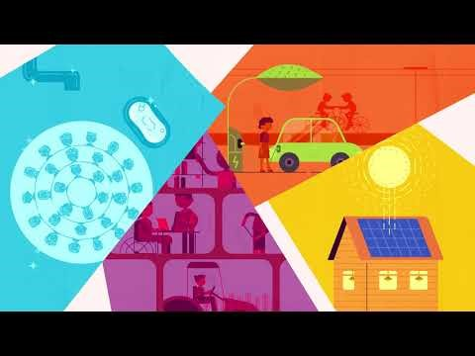
Notes:
UN Sustainable Development Goals - Overview – YouTube
Liz
Script:

Slide 5
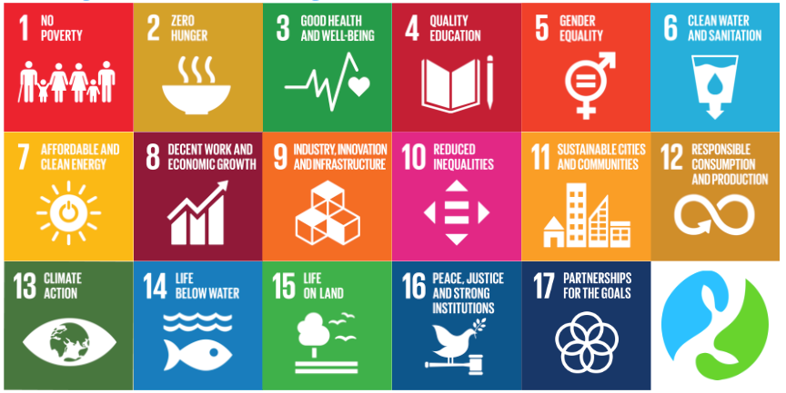
The SDGs can be used as a blueprint for peace and prosperity for the people and the planet - now and into the future
These 17 SDGs are integrated - they recognise that action in one area will affect outcomes in others, and that development must balance social, economic and environmental sustainability
Without anymore information than is on the screen - which would you say your department naturally ‘achieves’…
Notes:
Liz
Script:

Slide 6
What % of British people are, at least, moderately worried about climate change?
What % of British people are very or extremely worried?
How often do you think about climate change?
What % of young people experience difficulties with their mental health?
What proportion of these young people actively seek support?
Notes:
Unweighted- Quiz 1 multiple choice
Incomplete, needs answers inputting.

Slide 7
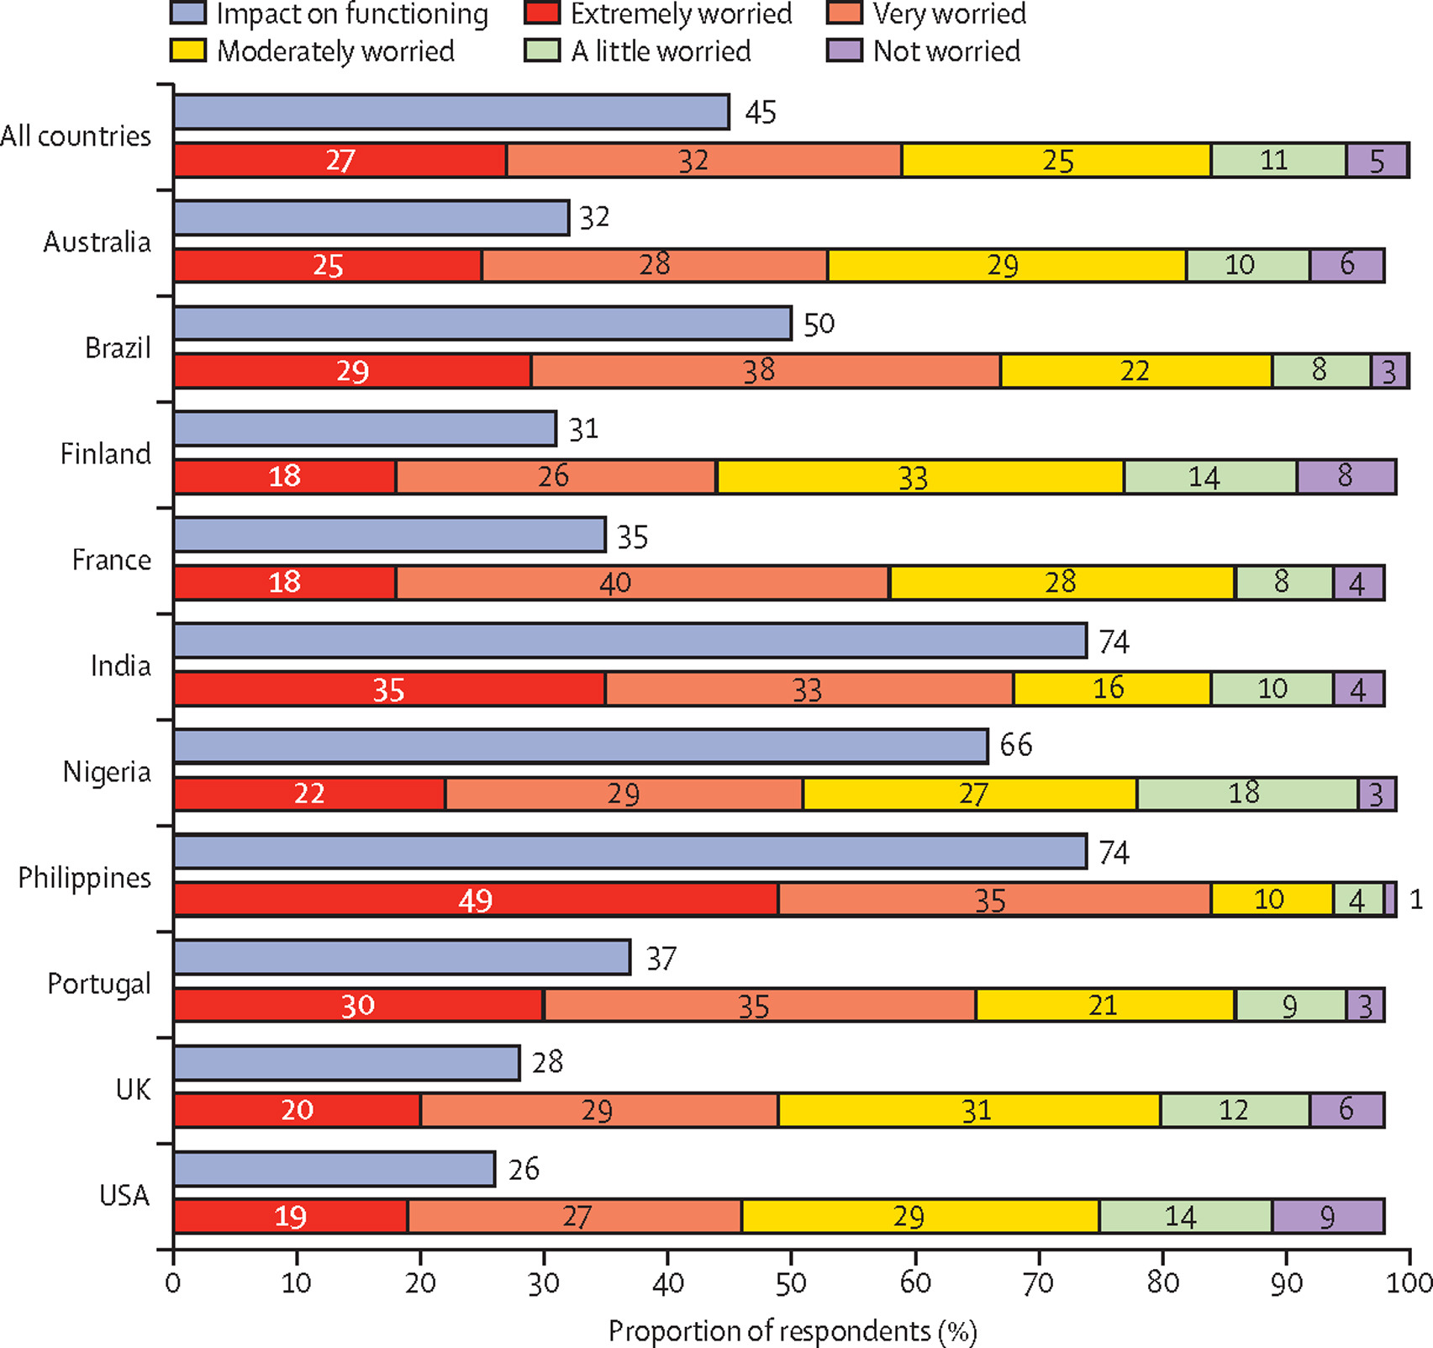
Data sampled from 10,000 16-25 year old sample
84% of all countries are at least moderately worried.
~50% of young people in UK are very/extremely worried.
Only 28% of young people trust the government to take appropriate action.
Other issues concerning young people at the moment include mental health and well being and equal opportunities (ONS)
Hickman. C et al. (2021) Climate Anxiety in Children and Young People and Their Beliefs about Government Responses to Climate Change: A Global Survey. The Lancet Planetary Health, vol 5 issue 12 p863-873
Notes:
Climate anxiety in children and young people and their beliefs about government responses to climate change: a global survey – ScienceDirect
Climate change: Young people very worried - survey - BBC News
Liz
Script:

Slide 8
Our objective is to promote:
Awareness
Discussion
Expectation
Increasingly ethically expectant students.
Our colleagues (and competitors) in the region are developing their sustainability practice and so should we.
Notes:
Phil
Script:
One of our primary objectives through this project has been to develop a common language around sustainability and the sustainable development goals in college. We hope, through the use of this common language and visibility of the SDGs, we will promote awareness of an institutional drive towards sustainable practice, create opportunities for discussion around how we can be more environmentally, economically and socially sustainable and finally to begin to instil individual expectations for commercial, educational and industrial institutions to be more conscientious in these areas.
Our students are becoming increasingly ethically minded and this will likely be followed by demand for practices that reflect these values. As studies have shown issues of equal opportunities, climate change and mental well-being weigh heavily on the minds of young people, it is our responsibility to be equipped to support them with these concerns. In the same was we offer support to students with mental health through the student union, we should be demonstrating the same willingness to address issues

Slide 9
There is an abundance of good practice already.
Trinity Green- Recycling Materials
Level 2s receive a sustainability award as well.
Bowling back lane- electric vehicles
Fashion and Textiles- fabric recycling
Teacher Education- developing future teachers
Notes:
Phil
Script:
There is an abundance of good practice already taking place around the college.
Our request to you is to apply the SDGs to your teaching wherever possible. Teaching values for sustainable development will be most impactful when it is part of regular discussion and is imbedded in our regular delivery as oppose

Slide 10
12- Responsible Consumption and Production
8- Decent Work and Economic Growth
11- Sustainable Cities and Communities
4- Quality Education
Notes:
Quiz 2 match up

Slide 11
8- Decent Work and Economic Growth
11- Sustainable Cities and Communities
4- Quality Education
12- Responsible Consumption and Production
Notes:
Quiz 2 match up

Slide 12
14- Life Below Water
10- Reduced Inequalities
3- Good Health and Well-being
6- Clean Water and Sanitation
Notes:
Quiz 2 match up

Slide 13
14- Life Below Water
10- Reduced Inequalities
3- Good Health and Well-being
6- Clean Water and Sanitation
Notes:
Quiz 2 match up

Slide 14
1- No Poverty
16- Peace, Justice and Strong Institutions
5- Gender Equality
15- Life on Land
Notes:
Quiz 2 match up

Slide 15
1- No Poverty
16- Peace, Justice and Strong Institutions
15- Life on Land
5- Gender Equality
Notes:
Quiz 2 match up

Slide 16
2- Zero Hunger
13- Climate Action
9- Industry, Innovation and Infrastructure
7- Affordable and Clean Energy
Notes:
Quiz 2 match up

Slide 17
2- Zero Hunger
13- Climate Action
7- Affordable and Clean Energy
9- Industry, Innovation and Infrastructure
Notes:
Quiz 2 match up

